Slide 1
Capstone Project
Restaurant Rating Prediction
By
Ravi Kumar

Slide 2
Problem Statement:
The main goal of this project is to perform extensive Exploratory Data Analysis(EDA) on the Zomato Dataset and build an appropriate Machine Learning Model that will help various Zomato Restaurants to predict their respective Ratings based on certain features.
Approach:
The classical machine learning tasks like Data Exploration, Data Cleaning,Feature Engineering, Model Building and Model Testing. Try out different machine learning algorithms that’s best fit for the above case.
Results:
You have to build a solution that should able to predict the ratings of the restaurants listed in the dataset.

Slide 3
Data Preparation
Dataset contains 51717 rows and 17 columns
The dataset contains one integer column, zero float column and 16 object columns

Slide 4
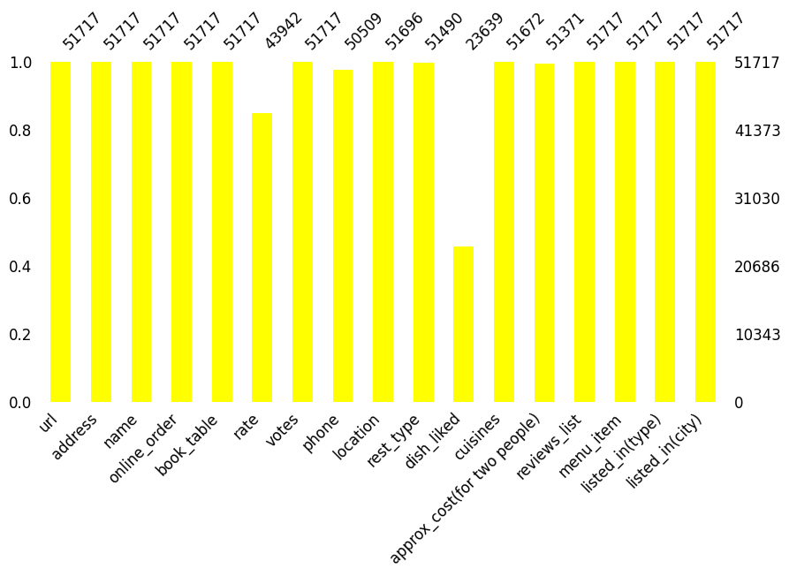
Null Values
There are some null values. Dish_liked column contain 54%, rate column contain 15%, phone column contain 2% and rest columns approx_cost, rest_type, cuisines, location columns has less than 1%.

Slide 5
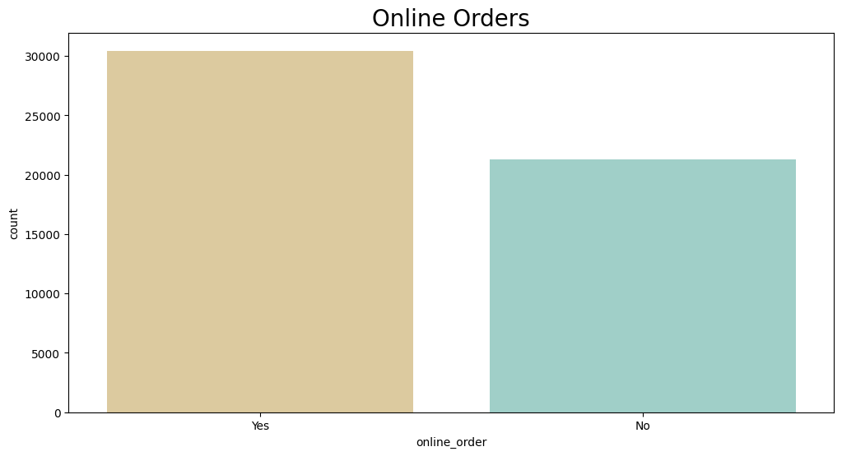
Exploratory Data Analysis
Online orders are more compare to offline orders. (almost 30000 orders are online and 23000 offline)

Slide 6
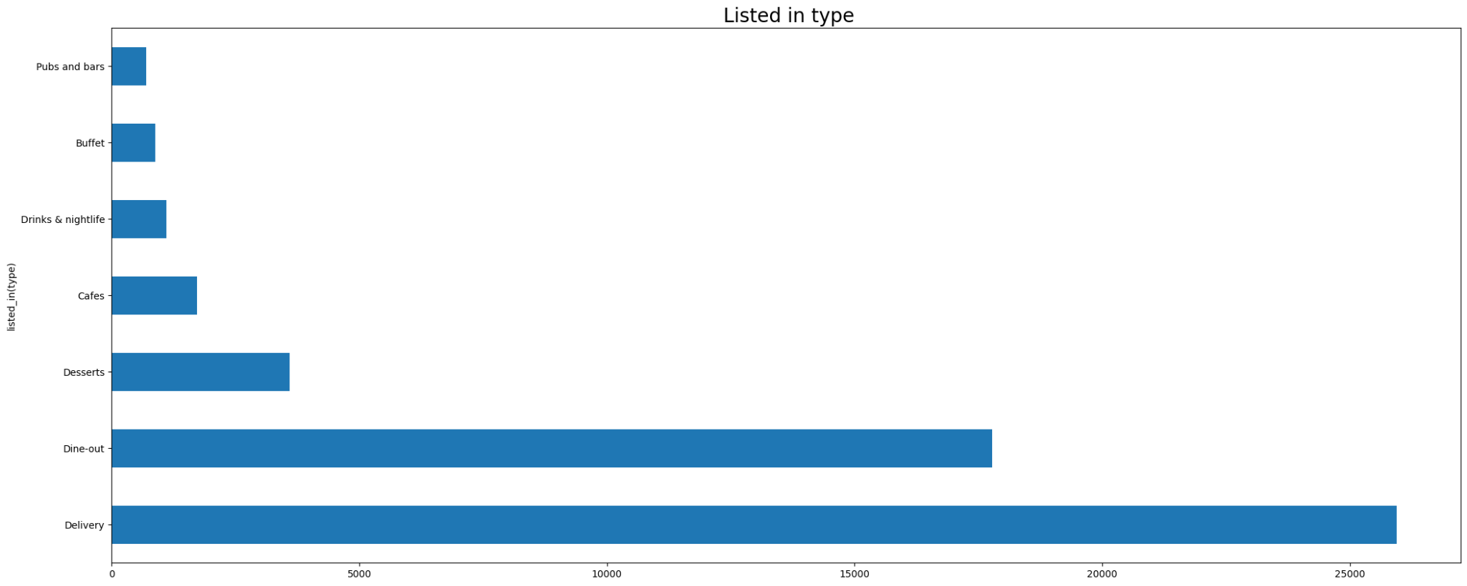
Exploratory Data Analysis
Delivery of food is more that is 50.2% and Dine-out is 34.4% compare to others listed in type

Slide 7
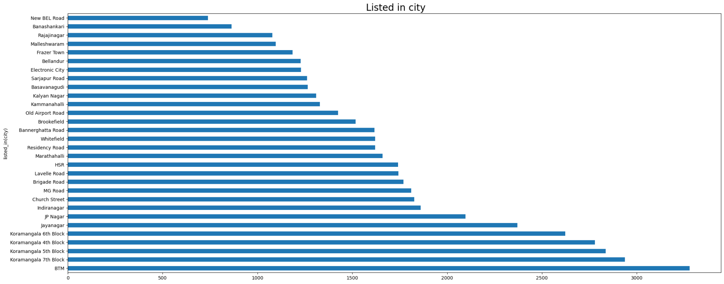
Exploratory Data Analysis
In listed city BTM and koramangala has more restaurant than compare to other locations.

Slide 8
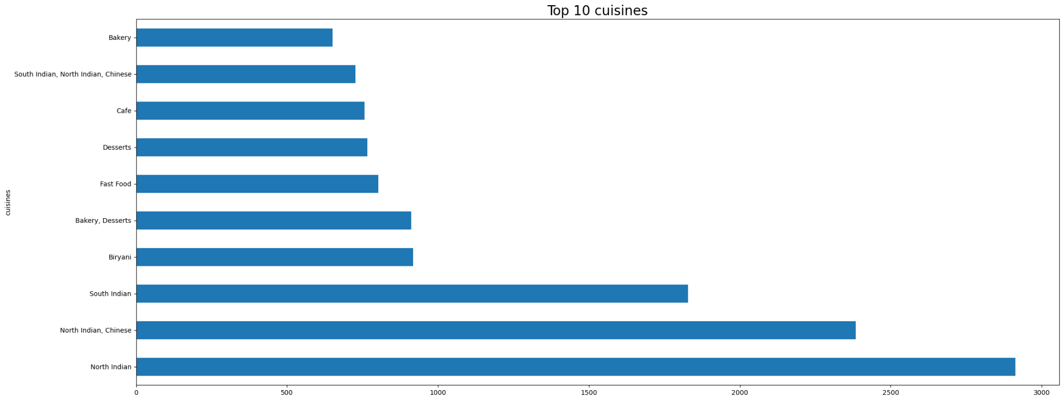
Exploratory Data Analysis
North Indian, North Indian Chinese and South India has more cusines than compare to other cuisines.

Slide 9
Exploratory Data Analysis
Quick Bites and Casual Dining are more restaurant types.

Slide 10
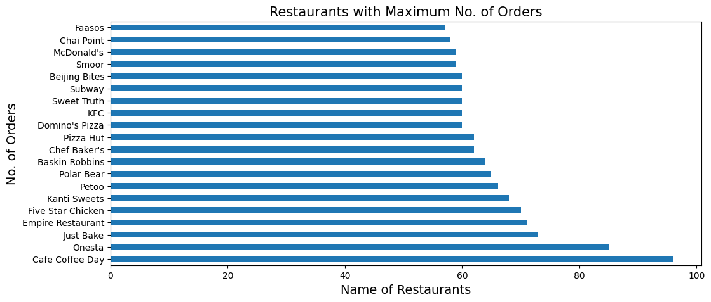
Exploratory Data Analysis
Top 20 restaurant in the city

Slide 11
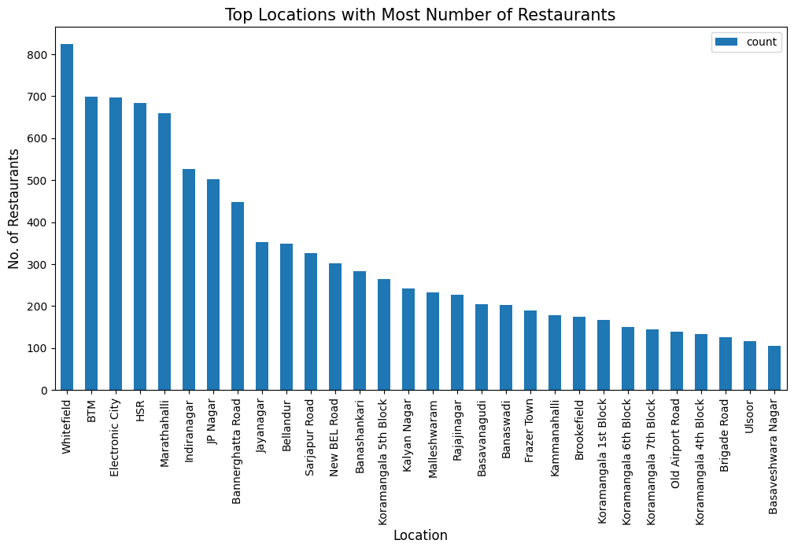
Exploratory Data Analysis
Top 20 famous restaurant location types in the city.

Slide 12
Encoding Columns
Encoding Online order, book table, location, restaurant type, cuisines, menu item, type

Slide 13
Split x_train and y_train
Assign x and y
Split x_train,y_train,y_train,y_test

Slide 14
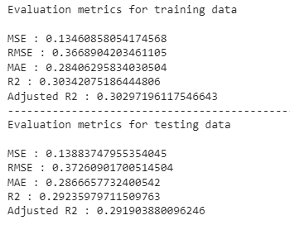
Model Building
Linear Regression

Slide 15
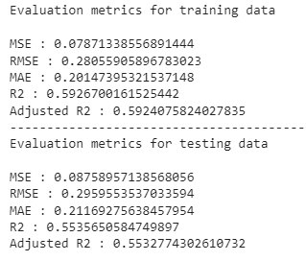
Model Building
Decision Tree

Slide 16
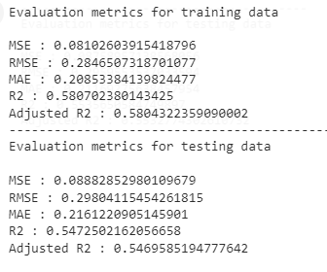
Model Building
Random Forest Regressor

Slide 17
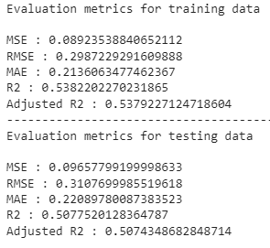
Model Building
Gradient Boosting Regressor

Slide 18
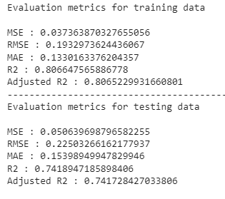
Model Building
XGBoost

Slide 19
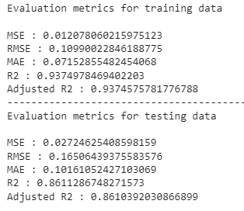
Model Building
Xgboost with Cross Validation

Slide 20
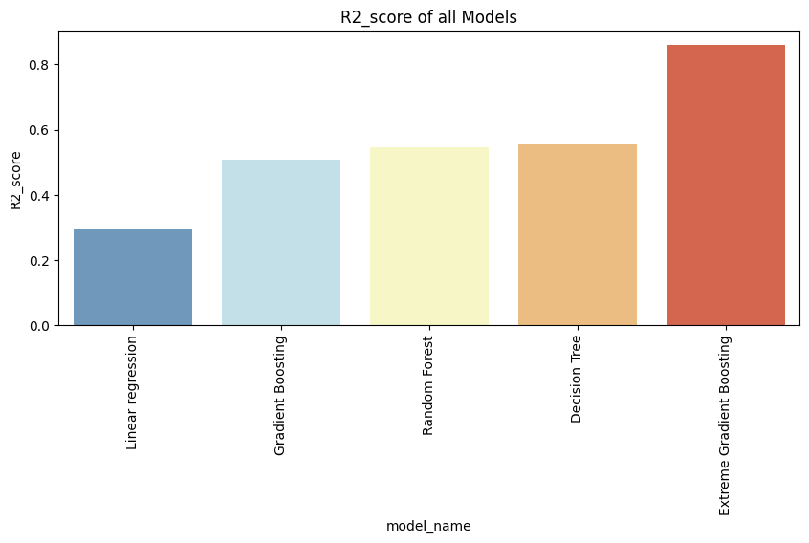
Result of all model

Slide 21
Summary
In this project, the primary objective was to predict restaurant ratings based on various features from the Zomato dataset. The approach involved classic machine learning tasks such as Data Exploration, Data Cleaning, Feature Engineering, and Model Building. Extensive Exploratory Data Analysis (EDA) was performed to understand the dataset and draw insights for building the model.

Slide 22
Summary
Key insights from the EDA revealed that:
Online orders are more frequent compared to offline orders, with around 30,000 online orders versus 23,000 offline orders.
Delivery is the most preferred type of service (50.2%), followed by Dine-out (34.4%).
Locations like BTM and Koramangala have the most restaurants compared to other areas.
North Indian, Chinese, and South Indian cuisines are the most popular choices.
The most common restaurant types are Quick Bites and Casual Dining.
The top 20 restaurant locations and top 20 famous restaurants in the city were identified.
The preferred cost for two people is ₹300, with around 7,000 orders in that range.

Slide 23
Summary
Following the data analysis, the data was encoded and prepared for machine learning model building. Various regression models were implemented, including:
Linear Regression
Decision Tree Regressor
Random Forest Regressor
Gradient Boosting Regressor
XGBoost
XGBoost with Cross-Validation (CV)
Among these models, XGBoost with Cross-Validation performed the best and was chosen for deployment. The final model and label encoders were saved as pickle files, and the solution was deployed using Flask.

Slide 24
Conclusion
This project successfully built a predictive model for restaurant ratings based on features such as online order availability, type of service, location, cuisine, and cost for two people. The insights gained from EDA helped in understanding customer preferences and trends in the restaurant industry. The XGBoost with Cross-Validation model was found to be the most effective and was deployed to provide rating predictions. This solution could help Zomato restaurants better understand the factors influencing their ratings and make data-driven decisions to improve their services.

Slide 25
Thank You

